Slide 1
Summer Internship Project 2021
Kuchuk Borom : Lead programmer
Gunarnab : Relational Database Architecture designer
Shrestha : Application flow designer
Mentor : Sir Dushyanta Datta

Slide 2
Contents Abstract section 1. Overview of the web application 2. Demonstration of the web application Technical section Frontend : 3. Language, framework & tools used 4. Snippet of Flutter’s UI pattern Backend : 5. Backend database Security rules 6. Database design pattern with example Misc : 7.Overall Application flowchart

Slide 3
Overview
Minimal is the name of our web application
Minimalistic social media platform
Users can register an account and setup their profile biography
Users can upload profile pictures, stories
Users can visit other user’s profile and check their stories

Slide 4
Features
Upload our Stories as well as check other’s stories and profile
Application is deployed in the web, can be accessed from anywhere in the world
Uses google’s cloud service as backend, ensures we have top notch security
Persistent data which is not bound to any device, If you lose your device you would still be able to login and access you profile and the contents in your profile

Slide 5
Structure of the source code
lib\main.dart - entry point of the code
Model(Classes to represent a structural data of some sort)
lib\Model\ProfileOther.dart - Class to represent a profile
lib\Model\Story.dart - Class to represent a story
UI classes(Responsible for renders on the screen)
lib\Pages\Edit_ProfilePage\EditProfilePage.dart - Renders the UI of “EditProfile” Page and has the functions related to it’s working
lib\Pages\Edit_ProfilePage\Global_Widgets\.. - Containers small classes that are UI elements
lib\Pages\Login_Signup\LoginPage.dart - Renders the UI of “Login” Page and has functions related to it’s working
lib\Pages\Login_Signup\Signup.dart - Renders the UI of “Signup” Page and has functions related to it’s working
lib\Pages\Search user page\SearchUserPage.dart - Renders the UI of “Search” Page and has functions related to it’s working
lib\Pages\Story_Page\StoryPage.dart - Renders the UI of “Story” Page and has functions related to it
lib\Pages\Story_Page\AddStoryPage.dart - Renders the UI of “Add Story” Page and has functions related to it
Provider classes( Create session persistent object which can be accessed in any page easily)
lib\Providers\Provider_Admin.dart - Contains function and variables with
lib\Providers\Provider_Firebase.dart - Configured objects from firebase SDK for persistent use
lib\Providers\Provider_Other.dart - Represents the Profile we visit
lib\Providers\Providers_User.dart - Holds crucial information about the logged in user such as their ID which will used to retreive information from the backend database

Slide 6
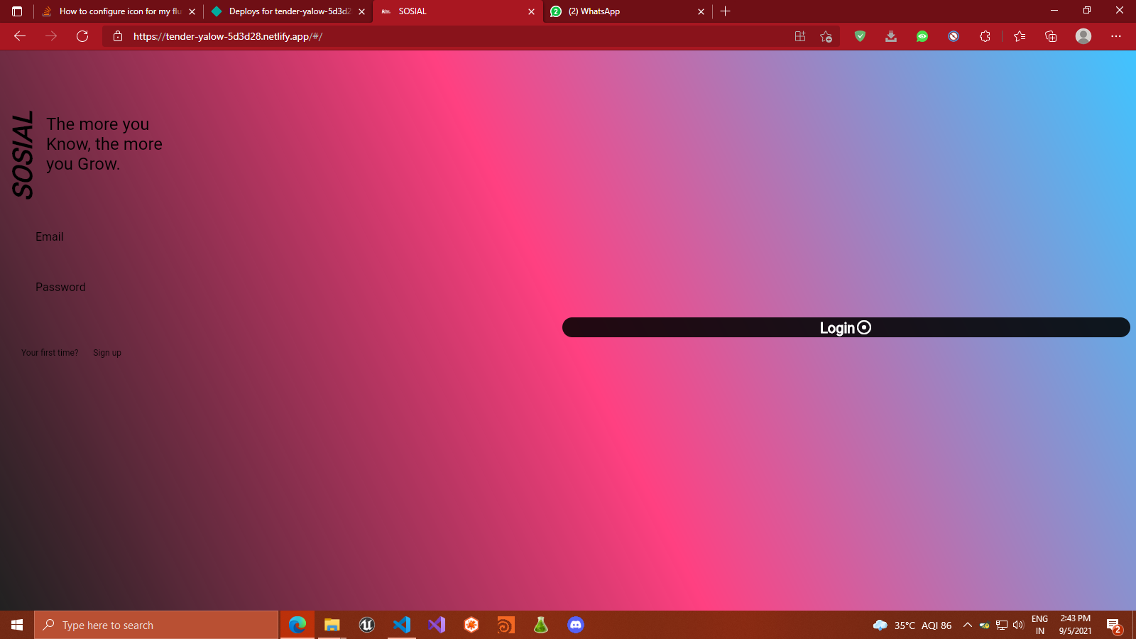
Demonstration

Slide 7
Technical Informations
Language : Dart
Frontend framework : Flutter (OOP based, multiplatform, state based framework)
Backend : Google’s firebase
Frontend tools:
1. Providers - state management solution
Backend tools:
Firebase storage, Firebase Firestore, Firebase Auth

Slide 8
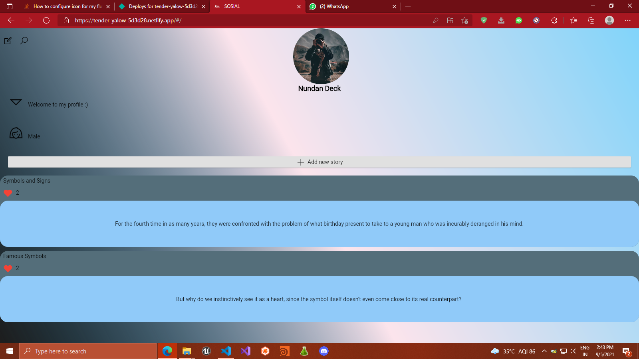
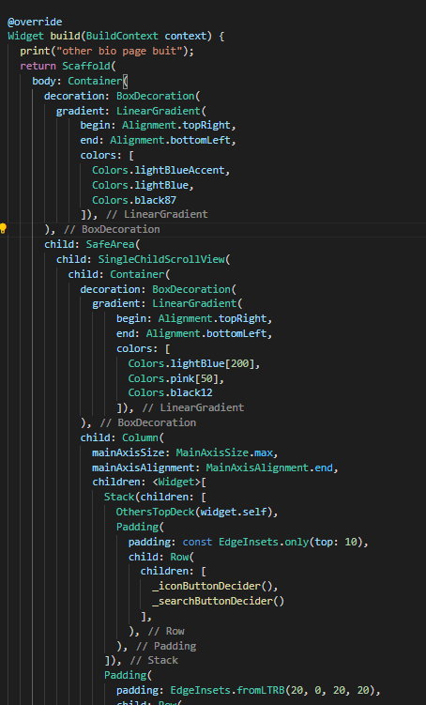
Flutter’s Designing Snippet

Slide 9
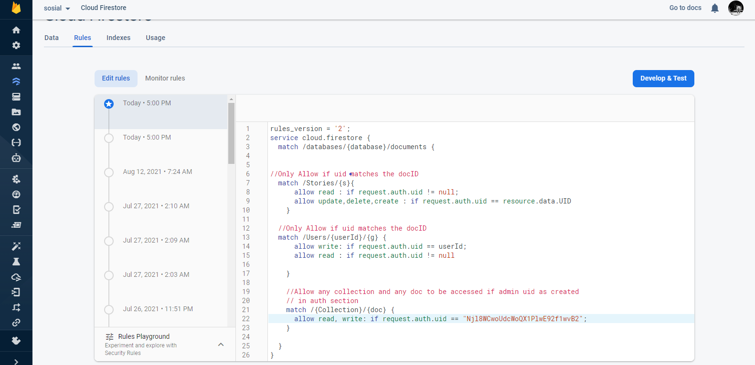
Backend security rules for database:

Slide 10
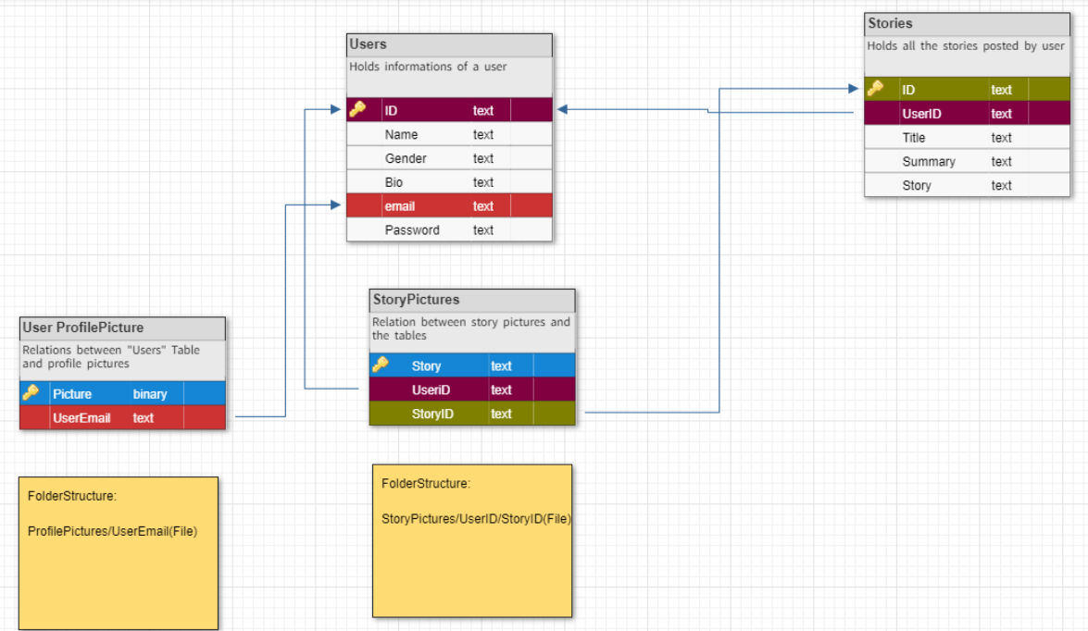
Relational Database design

Slide 11
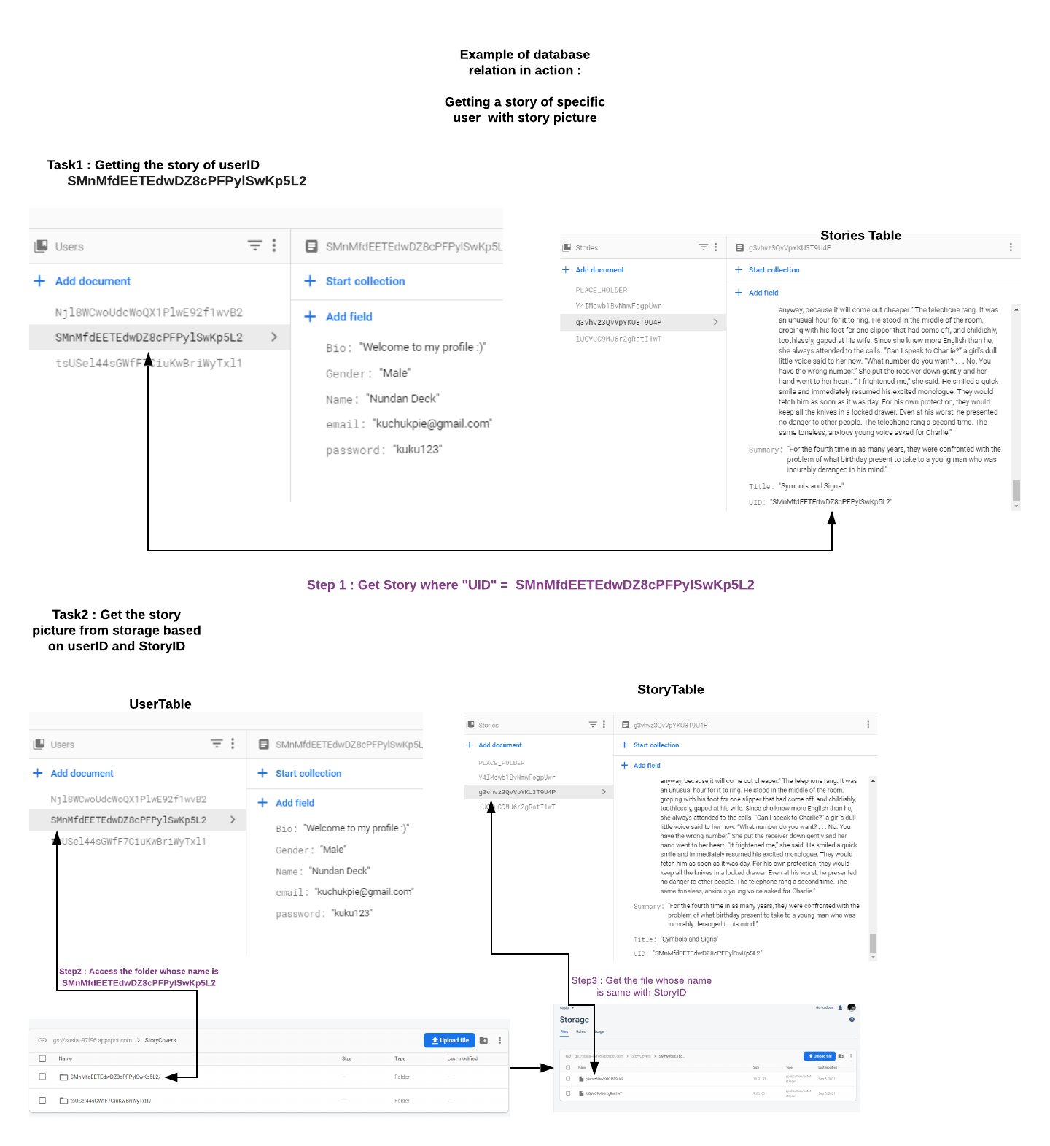

Slide 13
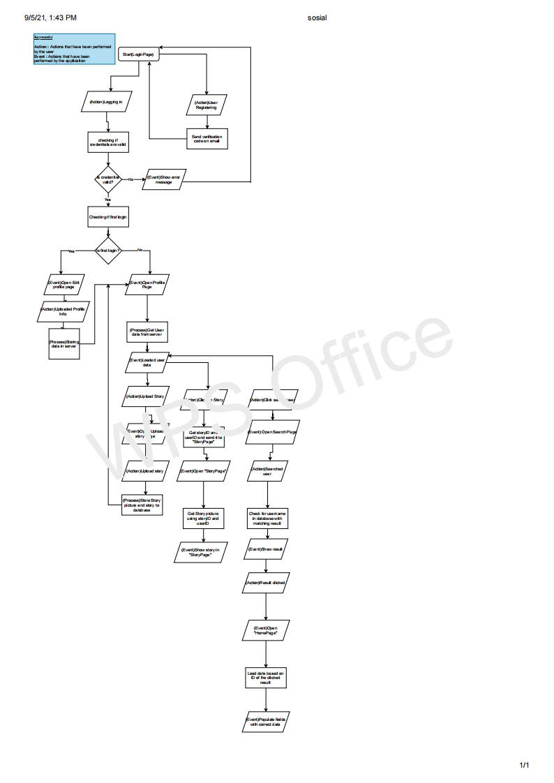
Application workflow
View PDF for higher quality

